Slide 1

Capstone Project Phase B 24-1-D-29
Carpool Match, Drive, Share
Supervisor Prof. Zeev Barzily
Submitters
Ben Ben Baruch Ben.Ben.Baruch@e.braude.ac.il Ravid Goldin Ravid.Goldin@e.braude.ac.il

Slide 2
Outline
Introduction
Problem Definition
Carpool’s Solution
Software Architecture
MVC Pattern
Challenges and Solutions
Project Metrics
Tests
Video of our application

Slide 3
Introduction
The Carpool project addresses inefficient public transportation and solo driving issues by offering an innovative mobile application.
Our solution connects drivers traveling regularly to the same destination, creating permanent carpooling groups.
This approach focuses on routine trips, fostering community and trust among participants, ultimately leading to more efficient, sustainable, and enjoyable commuting.
Notes:
אפשר להגיד כאן שהמטרה היא הטמעה של האפליקציה במקומות עבודה \ במכללה וכך לייעל את התחבורה.

Slide 4




Problem Definition
In today's urban environments, the prevalence of solo driving to common destinations like workplaces and educational institutions has led to numerous interconnected issues. This practice not only contributes to increased traffic congestion and higher fuel consumption but also elevates stress levels among commuters. Moreover, it significantly impacts the environment through increased pollution and exacerbates urban congestion problems.
Excessive single-occupancy vehicles
Scarcity of long-term carpooling solutions
Unequal distribution of carpooling costs
Environmental degradation
Notes:
בנוגע לשני, אופציה לשנות ל : Inconsistent carpooling options

Slide 5
Carpool’s Solution
Android and web application which:
Can be implemented for commuters in workplaces or colleges.
Creates permanent carpooling groups based on:
Shared schedules, compatible routes and available seats
Implements Fair Rotation System
Points-based driving allocation ensures equitable participation
Fixed locations displayed on in-app map for convenience
Builds trust and reliability among regular commuters
Notes:
אפשר להגיד כאן שהמטרה היא הטמעה של האפליקציה במקומות עבודה \ במכללה וכך לייעל את התחבורה.

Slide 6
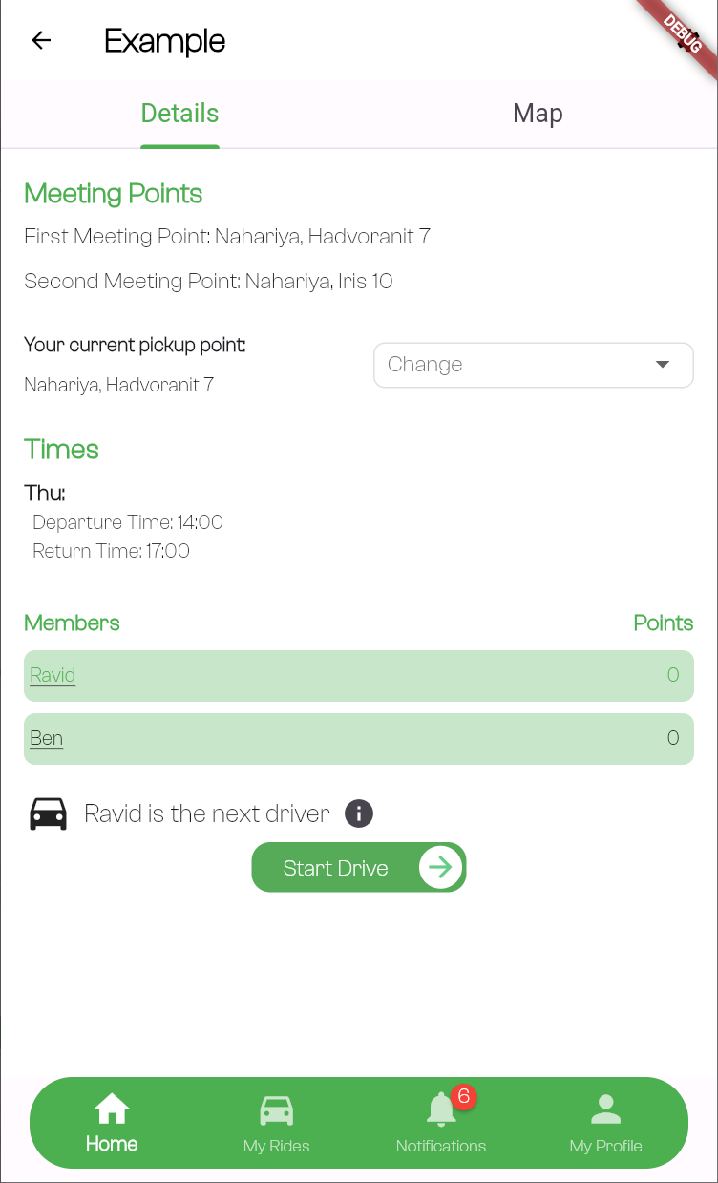
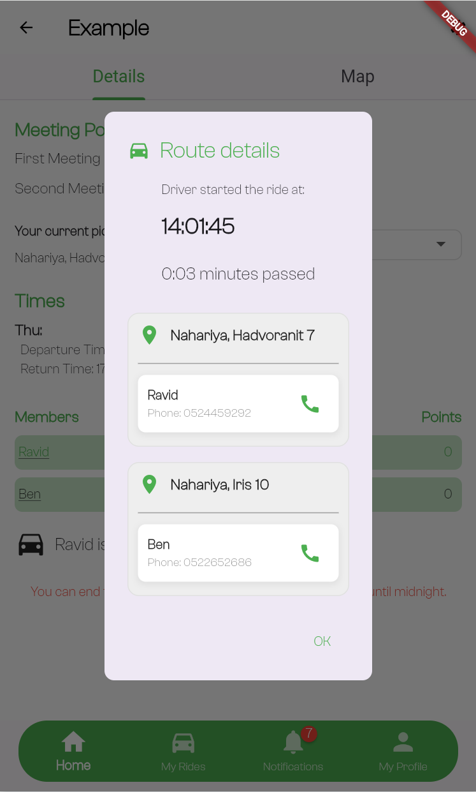
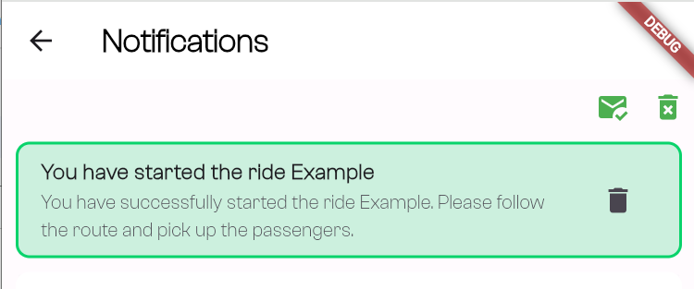
Timeline of a Carpool Ride
14:00 PM
14:01 PM
14:01 PM
Departure time
The driver and other group members receive a notification about the start of the ride
Window that pops up after the ride starts and showing all pickup points details
Opened only to the current driver
Can start drive 15 minutes before the departure time
Pickup point: Nahariya, Iiris 10
User to pickup: Ben
Notes:
Start Drive

Slide 7
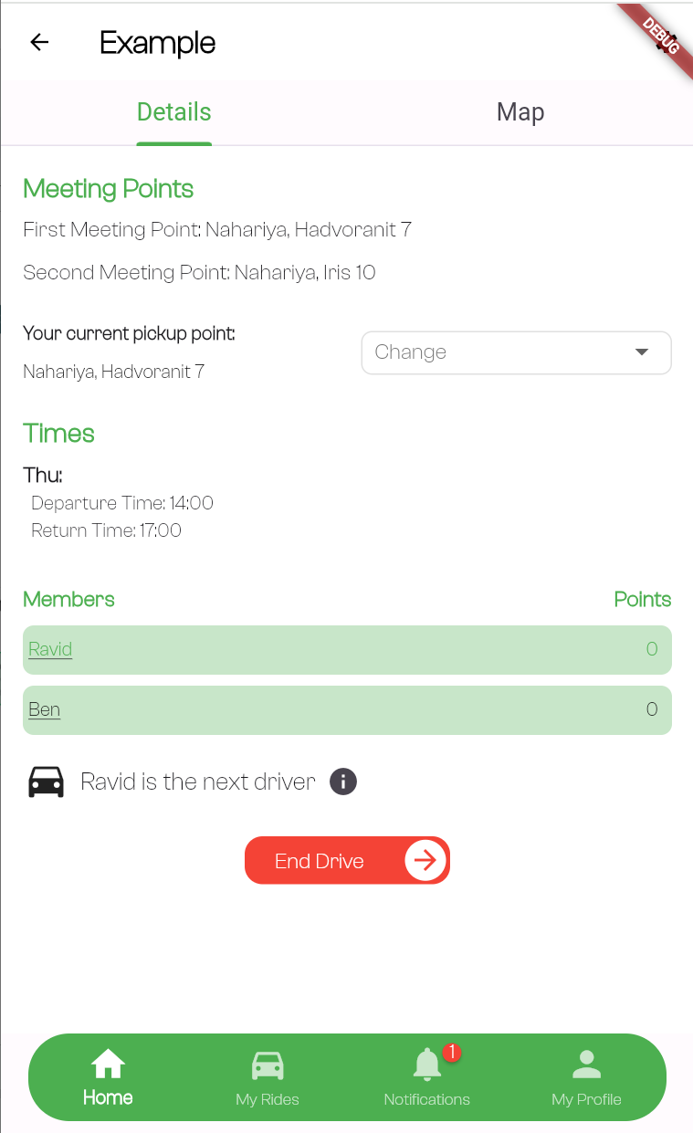
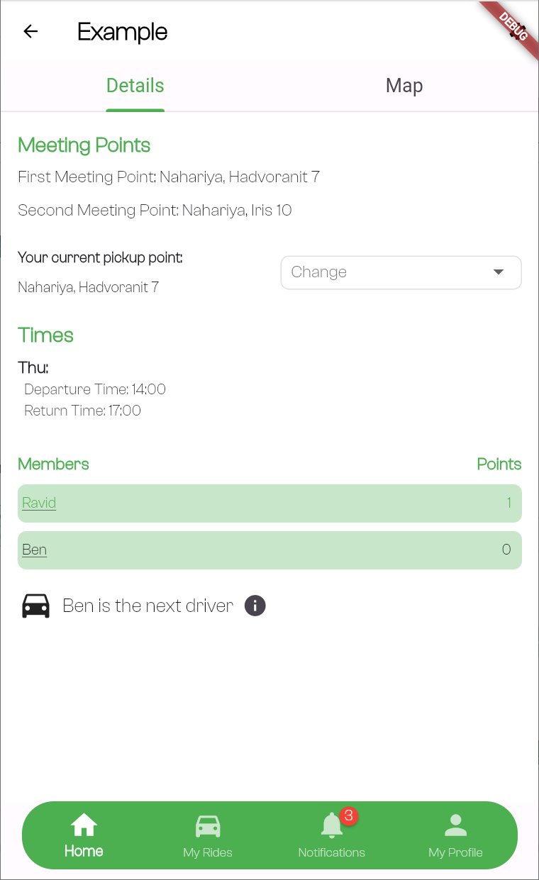

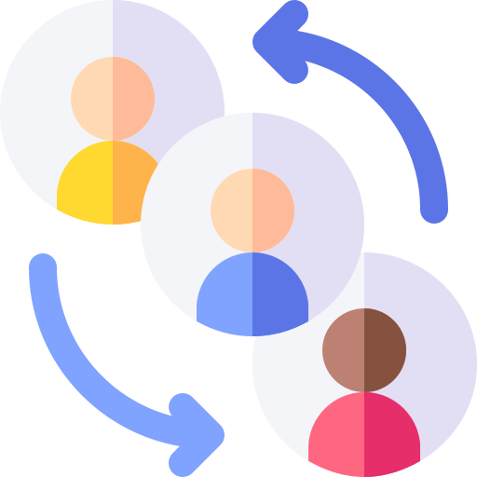
Timeline of a Carpool Ride
17:00 PM
17:01 PM
The driver received a point for his ride.
Can end drive from 10 minutes before the return time
Assigned new driver for next ride automatically
Notes:
Start Drive

Slide 8
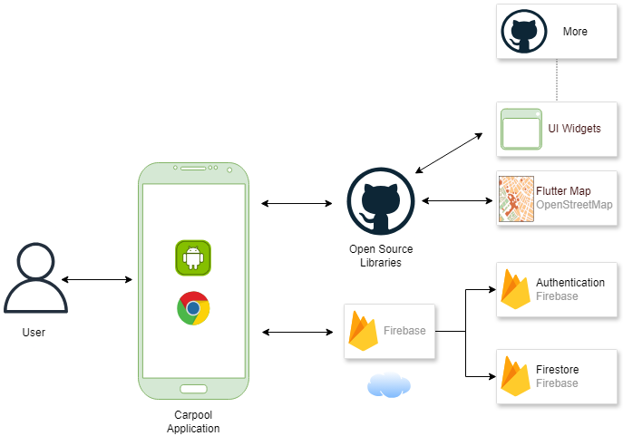
Software Architecture
Users interact with the Carpool app by creating or joining groups, choosing meeting points, and viewing routes. Actions are bi-directional, with real-time feedback.
The app manages user requests, data, and interactions with external services, processing inputs and handling business logic to ensure a seamless experience.
Firebase supports backend services like real-time updates and authentication, managing user data, group details, and notifications to keep users informed.
OpenStreetMap provides accurate, interactive maps for routes, meeting points, and stations, ensuring smooth navigation.
Notes:
There are more open sources library, for different functionality. No place in the slide so say it in presentation. For example, the loading spinner widget or other widgets.

Slide 9
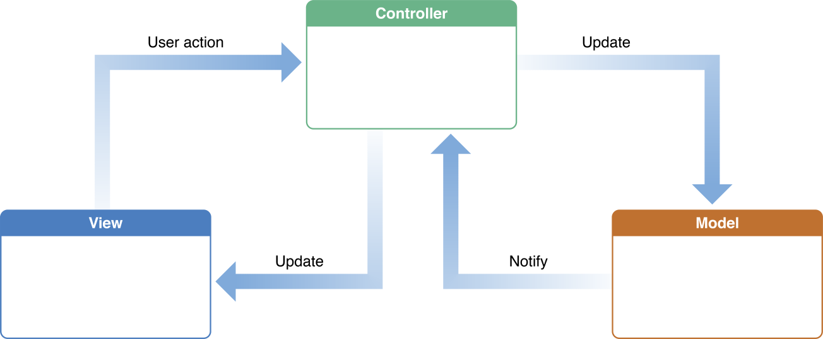
MVC Pattern
Model–view–controller (MVC) is a software design pattern commonly used for developing user interfaces that divides the related program logic into three elements:
Model: Manages application data, logic, and rules, independent of the user interface.
View: Displays data in different formats, allowing multiple representations of the same information.
Controller: Handles input and updates the model or view accordingly.

Slide 10
Challenges and Solutions
Architecture Implementation (MVC)
Challenge: Ensuring clear separation of concerns between Model, View, and Controller while maintaining app responsiveness and modularity.
Solution: Clearly defined roles for each layer (Model, View, Controller), focusing on minimizing dependencies to enhance maintainability and scalability.
Map Integration
Challenge: Integrating a reliable, cost-effective map service, with initial issues in Flutter support for Mapbox and cost constraints for Google Maps.
Solution: Implemented OpenStreetMap using Flutter packages (flutter_map, latlong2, geocoding), providing accurate location services while adhering to project budget constraints.
UI Experience
Challenge: Designing a user-friendly interface that presents complex information (rides, groups, routes) while remaining simple for diverse users.
Solution: Adopted an iterative design approach with user testing, improving features like group creation, route displays, and overall navigation, resulting in higher user engagement and satisfaction.
Notes:
UI experience
Challenge: Designing an intuitive user interface.
Solution: We asked friends and family to use the app on different devices and provide us with feedback.
אופציה נוספת:
Database Structure
Challenge: Designing an efficient Firebase database structure that minimizes operations while handling complex relationships between users, groups, and rides.
Solution: Used a well-planned database structure with collections and sub-collections, utilizing denormalization techniques to optimize performance and support scalable data retrieval.

Slide 11
Tests
During the development of the Carpool application, we conducted manual acceptance testing to ensure the app met specified requirements and was ready for users. This process involved verifying navigation, functionality, and overall user experience against predefined criteria for each feature.
Manual Testing Strategy: Started by testing screen layouts and navigation to verify structure and user flow.
Feature Testing: Manually tested major features like user authentication, group management, ride scheduling, searching and creating groups, and map integration after each development stage.
Real-World Scenarios: Focused on testing the points-based system and simulating real usage patterns to ensure functionality and user experience.

Slide 12

Thank you for listening!
Do you have any questions?

